Slide 1

Events Management: Principles & Practice, 4th Edition
By Razaq Raj and Tahir Rashid

Slide 2
Chapter 6
Costing, Pricing and Capital in Events Industry
Marginal and absorption costing
Contract Costing
Event costing
Break-even analysis
Pricing Methods for events and festivals
The role of Capital Investment decisions
Investment Appraisal methods

Slide 3
Classification of costs
Management accounting is a management information system for managers.
To analyse past, present and future data for decision making.
Traditional Costing Concept for Events:
  Historic costs: these are costs that have already been incurred
  Future costs: These are the costs that are going to be incurred in the future

Slide 4
Fixed and variable costs
The two main methods of costing to divide the company’s costs are fixed and variable costs and then between direct and indirect costs.
Fixed Costs
Variable Costs

Slide 5
Fixed Costs
The most common fixed costs:
Business rates paid to local authority
Interest paid on bank loans
Rent paid for the use of buildings or venues
Staff costs for a permanent member of staff
Company liability insurance

Slide 6
Fixed Cost Per Unit
Remains constant over a relevant range of activity levels.
Relevant range of a fixed cost - the range of activity levels within which that fixed cost tends to remain constant

Slide 7
Variable Costs
The most common variable costs:
  Hiring of venue
  Printing of marketing material
  Advertising
  Gust speakers
  Weekly wages paid to the staff working on the event
  Gas and electricity bills

Slide 8
Marginal Costing
Under marginal costing fixed costs are treated as period cost and fully charged to the period in which they incurred.
Contribution Formula
Contribution per ticket v Sales volume
Contribution less Fixed costs
Equals profit or loss

Slide 9
Marginal Costing Example
Notting Hill Carnival’s
 |  |  |  |  | Volume | Per ticket | Total
Sales |  |  |  |  | 12000 | £60 | £720,000
Variable costs |  |  |  |  | 12000 | £38 | £456,000
Contribution per ticket |  |  |  |  | 12000 | £22 | £264,000
Fixed costs |  |  |  |  |  |  | £87,000
Profit and loss |  |  |  |  |  |  | £177,000
Notting Hill Carnival’s break-even point |  |  |  |  |  | £87,000
 |  |  |  |  |  | £22 | £3,955

Slide 10
Absorption Costing
The absorption costing is opposite to marginal costing
The absorption costing method is significantly different from marginal costing
Under absorption costing full cost is treated to the event to service
It does not disregard the fixed cost from individual event or service

Slide 11
Absorption Costing Example
Notting Hill Carnival produced 15000 tickets for the event.
Direct production cost £20 per ticket
Direct labour £11 per ticket
Fixed costs are £95000 a month £per ticket
Sales are 14000 tickets at £60 per ticket
 |  |  |  |  |  |  |  | Per Ticket | Total
Sales |  |  |  |  |  |  |  | £55 | £550,000
Cost of Sales:
Direct production cost |  |  |  |  |  |  |  | £20 | £200,000
Direct labour |  |  |  |  |  |  |  | £11 | £110,000
Overheads |  |  |  |  |  |  |  | £6 | £90,000
Total cost of sales |  |  |  |  |  |  |  | £37 | £400,000
Profit and loss |  |  |  |  |  |  |  | £18 | £150,000

Slide 12
Contract Costing
The contract costing is a name given to job costing
Where contracts to be carried out at sophisticated level between the supplier and customer
The contract costing provides the company with an up to date picture of expenditure and revenue

Slide 13
Contract Costing
The structure of Contract
  The period of the contract
  The specification of the contract
  The location of the work of contract
  The agreed price for the contract
  The end product of the contract
  Agreed date for the contract to finish

Slide 14
Event Costing
Event Venue Hire Costs
Event Temporary Structure and Production Costs
Event Technical, Audio and Visual Costs
Event Entertainment and Artist Costs
Event Food and Catering Costs
Event Marketing and Advertising Costs
Event Staff and Security Costs
Event Planning, Registration and Administration Costs
Third Party Vendors Costs

Slide 15
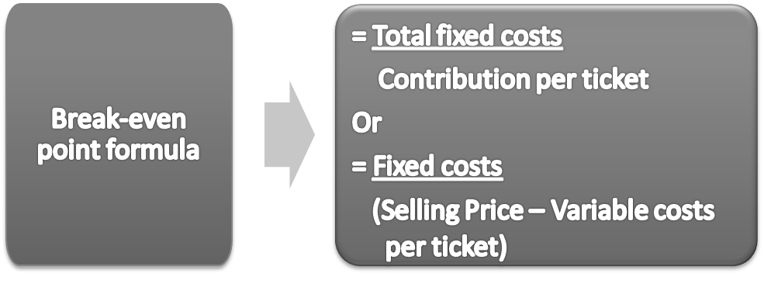
Break-even analysis

Slide 16
Capital Investment Techniques
Payback Period
Accounting Rate of Return
Net Present Value
Internal Rate of Return

Slide 17
Payback Period calculation
 |  | Project A |  | Project B
Year |  | Annual | Cumulative | Annual | Cumulative
0 | Cost | (100,000) | - 100,000 | (100,000) | - 100,000
1 | Cash inflow | 24,000 | - 76,000 | 18,000 | - 82,000
2 | Cash inflow | 18,000 | - 58,000 | 26,000 | - 56,000
3 | Cash inflow | 21,000 | - 37,000 | 40,000 | - 16,000
4 | Cash inflow | 16,000 | - 21,000 | 14,000 | - 2,000
5 | Cash inflow | 16,000 | -5,000 | 16,000 | 14,000
6 | Cash inflow | 25,000 | 20,000 | 11,000 | 25,000
 |  | 20,000 |  | 25,000
 | Project A: 5 + | 5,000 | years = 5.2 years*
 |  | 25,000
 | Project B: 3 + | 22,000 | years = 4.1 years*
 |  | 24,000

Slide 18
Accounting Rate of Return
 | Project A | Project B
Accounting Profit = (∑ inflows) – initial investment | = £120,000 – £100,000 = £20,000 | = £125,000 - £100,000 = £25,000
Average annual profit = accounting profit ÷ n years | = £20,000 ÷ 6 = £3,333 | = £25,000 ÷ 6 = £4,167
Average Investment = (initial asset value + closing asset value) ÷ 2 | = (£100,000 + £0) ÷ 2 = £50,000 | = (£100,000 + £0) ÷ 2 = £50,000
ARR (average investment) = Average annual profit x 100 Average investment | = £3,333 x 100 £50,000 = 6.67% | = £4,167 x 100 £50,000 = 8.33%

Slide 19
Net Present Value
Year |  | Amount | Discount Factor 4% | Present Value | Amount | Discount Factor 3.5% | Present Value
0 | Cost | -80,000 | 1 | -80,000 | -80,000 | 1 | -80,000
1 | Cash inflow | 20,000 | 0.962 | 19,240 | 19,000 | 0.962 | 18,278
2 | Cash inflow | 19,000 | 0.925 | 17,575 | 15,000 | 0.925 | 13,875
3 | Cash inflow | 20,500 | 0.889 | 18,225 | 36,000 | 0.889 | 32,004
4 | Cash inflow | 14,000 | 0.855 | 11,970 | 16,000 | 0.855 | 13,680
5 | Cash inflow | 12,000 | 0.822 | 9,864 | 12,000 | 0.822 | 9,864
6 | Cash inflow | 27,000 | 0.79 | 21,330 | 8,000 | 0.79 | 6,320
 |  |  | NPV = 18,204 |  |  | NPV = 14,021

Slide 20
Summary
The main aspects of cost accounting are to provide information to organisations
The costs are broken into direct or indirect
Costing classification is marginal costing and absorption costing
The break-even analysis technique
Capital investment methods

Slide 21
Further Reading
Atrill, P. and McLaney, E. (2017) Accounting and Finance for Non-specialists, 10th edn. Pearson
Drury, C. (2018) Management and Cost Accounting 10th edn. Cengage Learning EMEA
Raj, R. Suleman, A. and Beck, V. (2019) The Utilisation of Value Based Management in the Strategic Management of German’s Automotive Industry. Journal of Global Business Review. Sage Publishing. https://doi.org/10.1177/0972150919845236

